Slide 1
Preparation for your Presentation
The judges will assume the role of venture capitalists looking to financially invest in your product - think "Shark Tank”
1-5 Slides
Quick Intro Slide with Business Unit and Team Members
Real World Problem or Challenge addressed or identified
Identify the end users for your product
Benefits to be realized from your solution
Important! Your presentation must include the technical architecture of your solution. See Slide 2 for example. Simple Flow Diagram is best.
Highlight IBM technology used in this diagram. Judges will be interested in this.
Highlight any next steps. Technological viability, anticipated challenges and your plan to overcome
Tips for a powerful presentation
1:00 minute on the problem/solution your team is trying to solve. Users / viability in the market
2:00 minutes High Level Architecture Demo, User Flow,
1:00 Minute on Results and Next Steps

Slide 2
Format
Each team will have 4 minutes to present
2 minutes will be given for Q&A
Winners will be announced once all teams present from each theme
Team members will need to join: https://ibm.webex.com/meet/dwasson
Monday, July 27th at 2:55pm EST. I’ll open my WebEx at 2:30pm EST
Presentation Order will be given on Monday

Slide 3
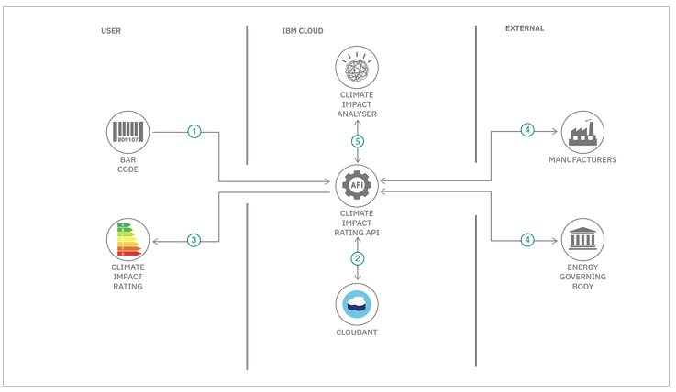
Technical Architecture

Slide 4
Evaluation Criterion
How Judges will evaluate your MVP
25%
25%
Completeness & Transferability
How fully has the idea been implemented ?
Can it achieve an impact in the field?
Can it be transferred elsewhere?
Design & Usability
How good is the design, user experience, and ease of use of the solution?
How quickly can it be put to use?
25%
25%
Effectiveness & Efficiency
Does the solution address a high priority area?
Does it achieve its goal effectively and efficiently?
Can it scale?
Creativity & Innovation
How unique was the approach to solving a long-standing or previously intractable problem?

Slide 5


2020 Hackathon Prizes

